Slide 1

TimeStamp
“Timekeeping Made Easy”
Jason Jamil, Steve Haikio, Alex Jabiro, Patric Abbo, Stefen Orban, Mario Saad, Adrian Pekala

Slide 2

FEATURES & FUNCTIONS
The Features for TimeStamp are:
Allow new users to create accounts
Assigned projects will show up under each user account
Give users the ability to punch in/out of said project
All data will be stored in the database and will be accessible to accounts with admin rights only
Allow admins to change/edit any user account and assign new projects to specific users
Admins will then be able to see all user accounts and the time spent on each project
Mobile friendly
Allow users to be able to submit expense reports for each project
Generate invoices to be billed out for each user

Slide 3

THE CHALLENGES
Becoming familiar with DCAA Compliances
Setting up GitHub to work with AWS
Setting up and hosting our own AWS server
Working with AWS
Setting up phpmyadmin in AWS
Learning different languages

Slide 4
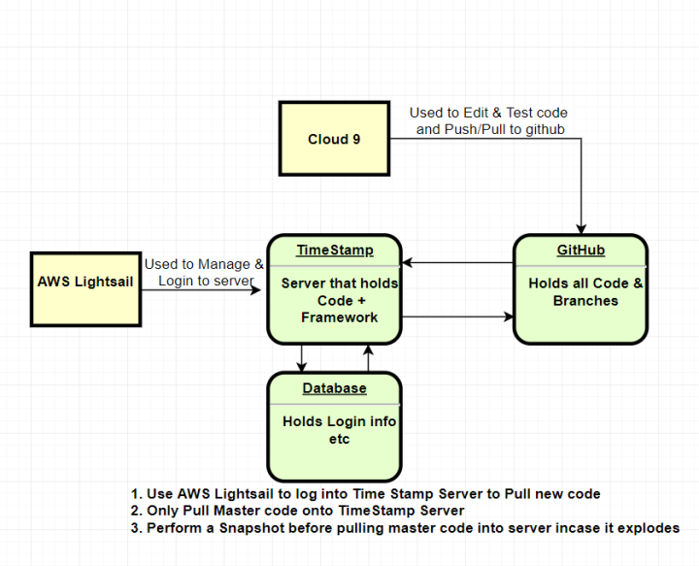
Workflow

Slide 5
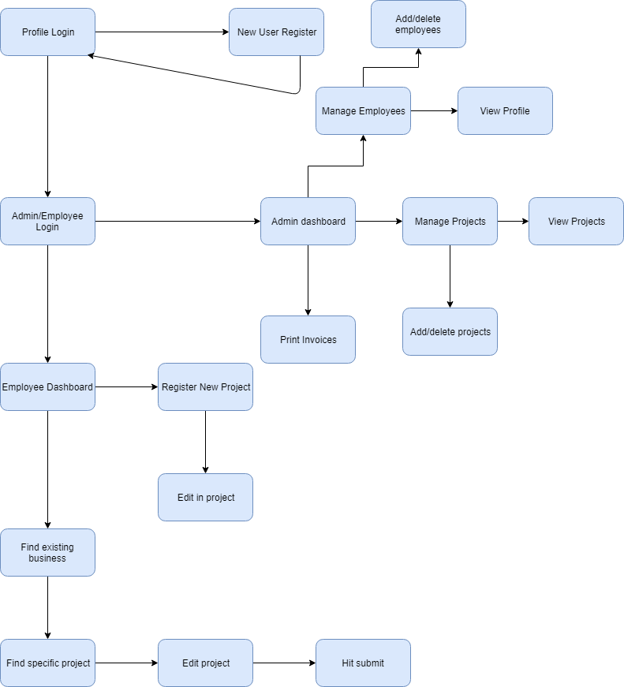
UX
FLOW
CHART

Slide 6
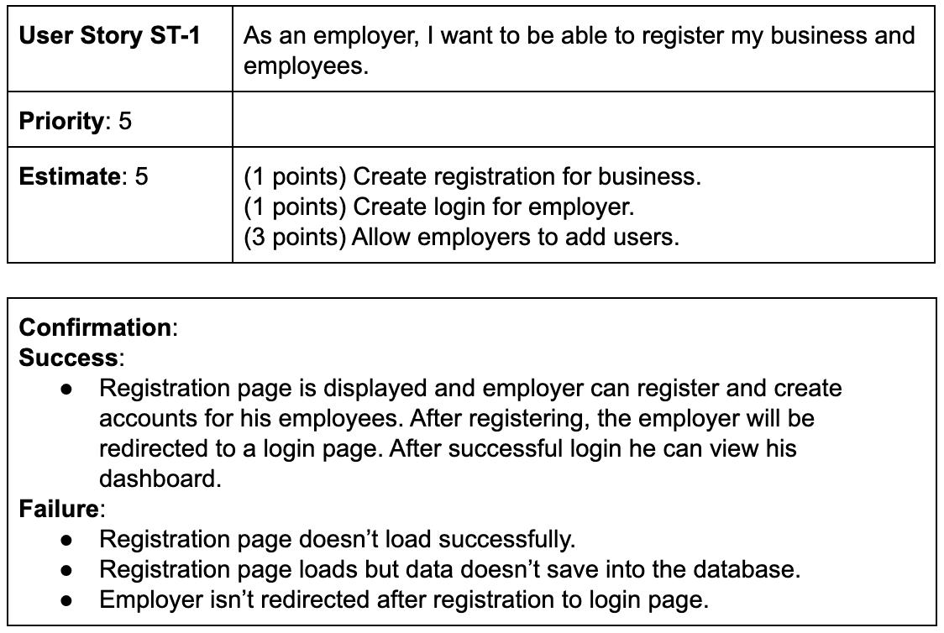
USER
STORIES

Slide 7
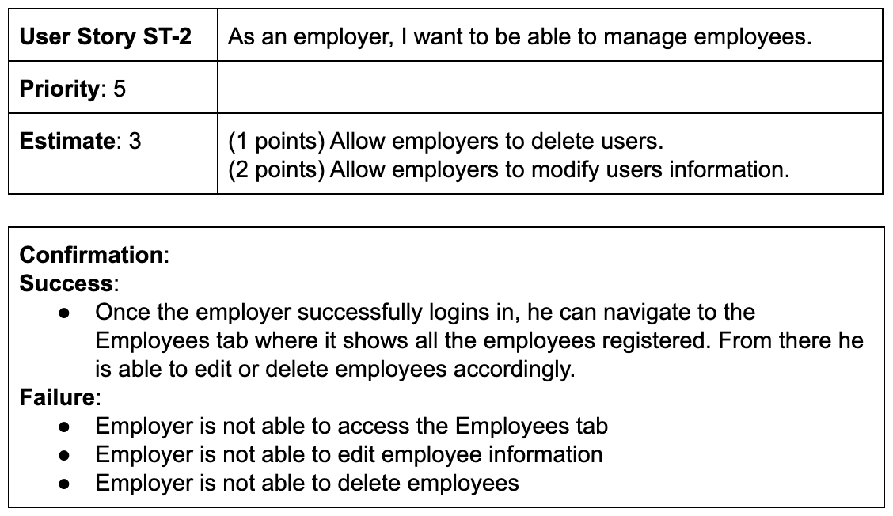
USER
STORIES

Slide 8
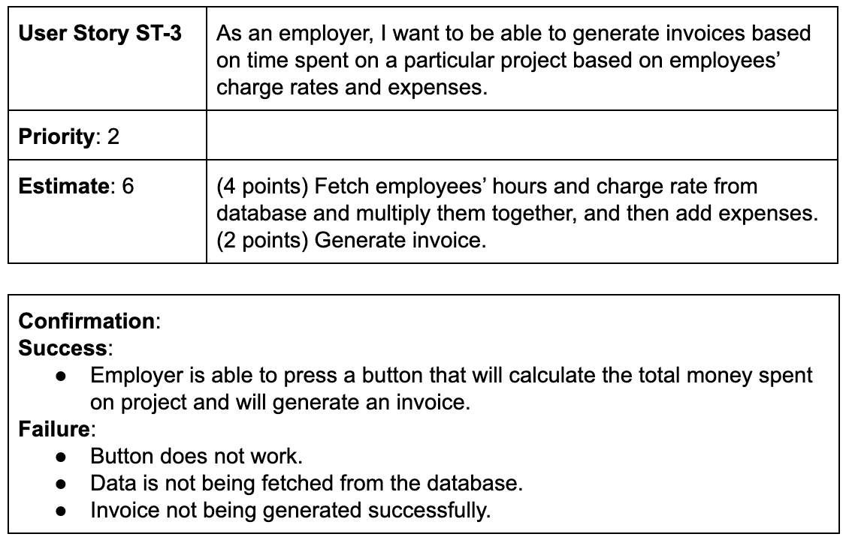
USER
STORIES

Slide 9

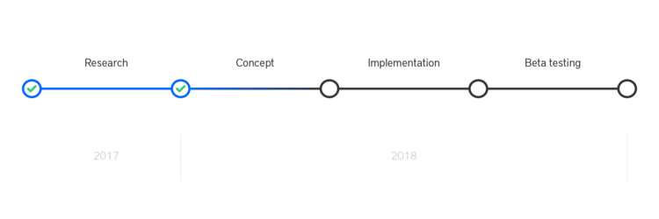
SPRINT PLANNING
Sprint 1: Come up with the idea of how to execute the project and align on all the tools to use. Create and have a working AWS server to host our database along with the site that users will use to punch in and out. (Complete by 9/12/19)
Sprint 2: Create the site using HTML. The site will consist of 2 seperate types of accounts: Admin and standard user. Standard users will also have the ability to create a “New User” Admins will have access to view all timecard data and make changes if need be. (Complete by 9/19/19)
Sprint 3: Connect the site to the database to allow user punches to be stored. Being able to write to the database will then allow admins to have access to all time data. (Complete by 10/3/19)

Slide 10
SPRINT PLANNING
Sprint 4: Assign privileges to each type of account with DCAA compliance.. Admins will have full privileges over the database and will be allowed to make changes as need be. (Complete by 10/15/19)
Sprint 5: Test standard user account. This will ensure that when making a standard user account, their punches are stored accordingly in the database and are accessible by the admins (Complete by 10/29/19)
Sprint 6: Allow admins to be able to make changes to the punches accordingly. This sprint will consist of making sure that each account type works and that admins will be able to view and edit the data. (Complete by 11/12/19)

Slide 11

LOGIN DEMO

